Slide 1
INTRODUCTION

Slide 2
OVERVIEW
Overview : On Bayesian Network and Outlier Detection
https://www.researchgate.net/publication/228665983_On_Bayesian_Net work_and_Outlier_Detection, cited by 5
2)Anomaly Detection Through a Bayesian Support Vector Machine
Citation count:53 citations counts(52 paper citation and 1 patent citation)
Source:-https://ieeexplore.ieee.org
Application Domain: early system-level health assessment, failure diagnostics, and prognostics for electronics.The objective in this case study was to test the algorithms on a system that was degrading, and in which the degradation took place in the presence of considerable noise
3) GLAD: Group Anomaly Detection in Social Media Analysis
Citation Count 63 Source - https://arxiv.org/pdf/1410.1940.pdf
Application Domain - detect anomalous behavior in social media and physics

Slide 3
Anomaly Detection Through a Bayesian Support Vector Machine
Problem Statement
To analyse the reliability of a product from a health monitoring perspective, which allows a methodology that permits the reliability of a product to be evaluated in its actual application conditions using novelty detection and to investigate the use of a one-class support vector machine algorithm to detect the system anomalies, and to give output classification probabilities, as a way to monitor the health of a system.

Slide 4
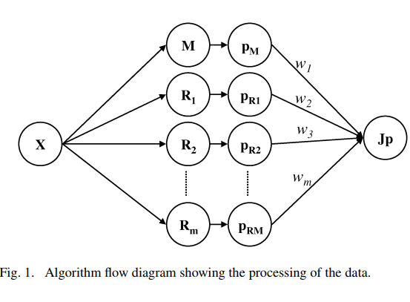

Approach
We approach the problem of novelty detection and health evaluation based on support vector machine (SVM) classifiers. We use their connection to Bayesian linear models (BLM) to model the posterior class probability for future test data. The Bayesian SVM algorithm is trained in the absence of failure data (negative class data), as is the case in many mission-critical systems. The negative class sample is estimated through a non-parametric density estimation technique, and through analysis of the gradient of the resulting likelihood function.

Slide 5
Data Set Description
Lockheed Martin servers:-The first 800 observations were used as the positive training class, during which no failures occurred. The remaining data were used as the test data, which included three periods of failures.
Simulated Degradation Data

Slide 6
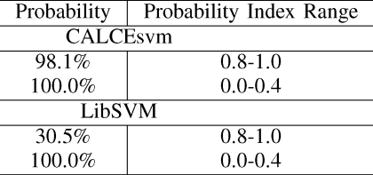
Result Achieved
Lockheed Martin Servers Data

Slide 7
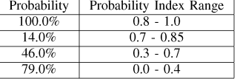
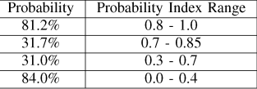
Result Achieved
Simulated Degradation Data
LIBSVM CALCESVM

Slide 8
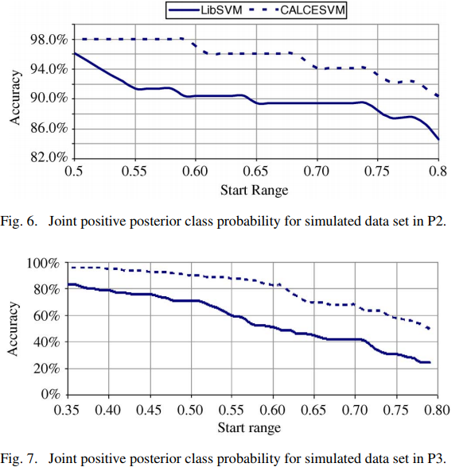
Result Achieved
Simulated Degradation Data

Slide 9
LIMITATIONS AND SHORTCOMINGS
1) The estimation of the negative class can in many cases be over-conservative, depending on how the user specifies the threshold.
2) The choice of decomposition detail can affect the accuracy (here we used two two-dimensional models).
3) Insufficient data corresponding to the healthy states of the system is presented to the algorithm.

Slide 10
Overview : On Bayesian Network and Outlier Detection
Repository:
1.https://www.researchgate.net/publication/228665983_On_Bayesian_Net work_and_Outlier_Detection, cited by 5
2. https://www.cse.iitb.ac.in/~comad/2010/ResearchTrack/paper%2017.pdf, cited by 16
Application domain:
Anomaly detection in Video surveillance, Intrusion detection in network, Health care.
Problem with previous approaches-
Clustering based approaches – assumptions outliers either does not belong to any clusters or form small clusters. So highly dependence on suitable metric for clustering.
use of Bayesian network –rely on the availability of accurate labels for various classes, which is, most often not possible
Distance based methods – Computationally costly, perform poorly when the dataset
has regions of varying densities

Slide 11
Problem statement
Dataset
● Introduce two quantitative rules derived from the Bayesian network to uncover outliers. furthermore, used these rules to rank the instances also explain why they are likely to be so
based on joint probability distribution in the Bayesian network
total ten datasets,
out of which five were simulated from validated Bayesian model and
rest were real datasets from which Bayesian models were learnt
each dataset, the notation (i * j) indicates that the dataset had i number of instances and j number of attributes.
Real Datasets are
1. Hepatitis(155 * 19) 2. Breast cancer(184 * 9) 3. Statlog(1000 * 20)
4. Ecoli(336 * 8) 5. Boston housing(516 * 14)

Slide 12
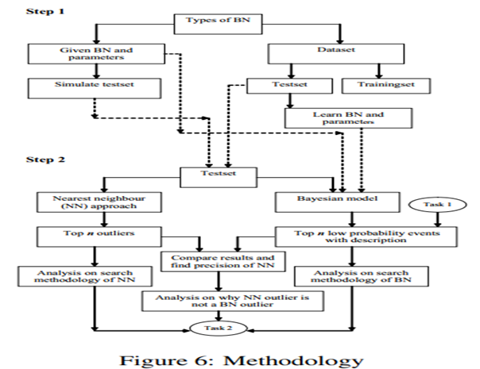
Approach
Step1.
identification and description
Step2.
analysis of false outliers

Slide 13
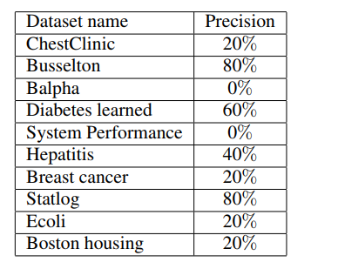
Result achieved

Slide 14
GLAD: Group Anomaly Detection in Social Media Analysis
Problem Statement
Traditional methods seek for a single point of anomaly while it might happen that a group of people could collaborate to anomalous behavior specially on social media. The authors propose a hierarchical bayes model to detect such groupwise anomalies.
Further due to dynamic nature of social media, the groups might keep changing hence they also propose a dynamic extension of their model to adapt to changing behavior

Slide 15
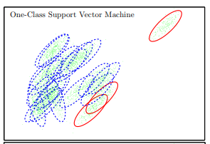
Example of group anomaly
Applications
Finding new physical phenomena by detecting anomalous groups of particles
Galaxy Identification
Can be used to study corporate restructuring, team-job hopping and shift in political inclination

Slide 16
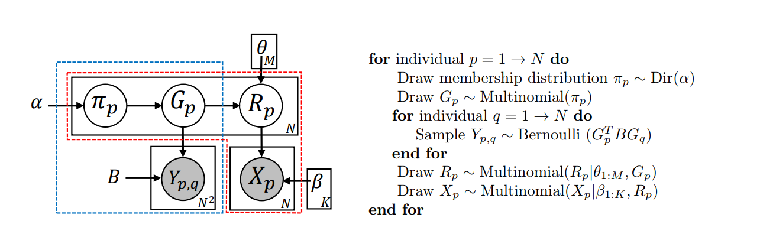

GLAD - Group Latent Anomaly Detector model
G - denotes group person p belongs to R - denotes role of person in the group
Y - denotes whether p and q are connected X - denotes the activities of a person p
The parameters are updated using variational inference.
We score the group anomalousness using

Slide 17
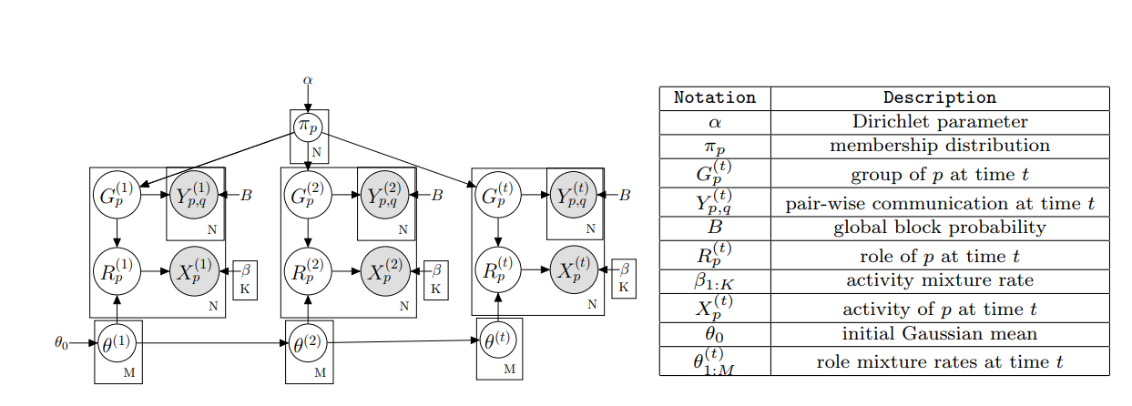
Dynamic extension
In this case anomalies are located in both space and time i.e. a group is anomalous if it changes too fast in a timestep.
They use Monte Carlo Sampling at each timestep and particle filtering to infer along time

Slide 18
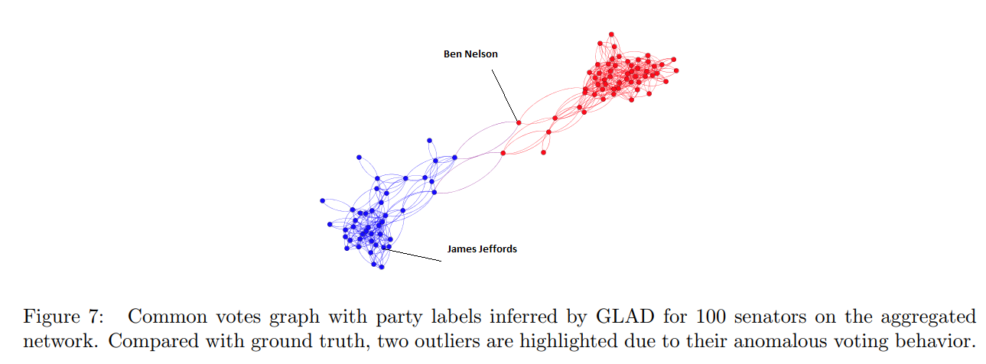
Dataset
US Senate Voting
Dataset contains records of 109th Congress with 100 senators’ voting, spanning Jan 1st 2005 to Dec 31st 2006.
Since there are only 2 groups, there is no point in detecting anomalous groups so instead, they use d-GLAD to detect anomalous time points.
d-GLAD raises an alarm at the 7th time-step for Democratic. A well known political event happened during this time is that Democratic senator Joseph Lieberman lost the Democratic Party primary election and became a independent Democratic in September 2006 which was captured by their model

Slide 19
References
GLAD: Group Anomaly Detection in Social Media Analysis - cited by 63 https://arxiv.org/pdf/1410.1940.pdf
One-Class Support Measure Machines for Group Anomaly Detection -cied by 38 https://arxiv.org/pdf/1303.0309.pdf

